Slide 1
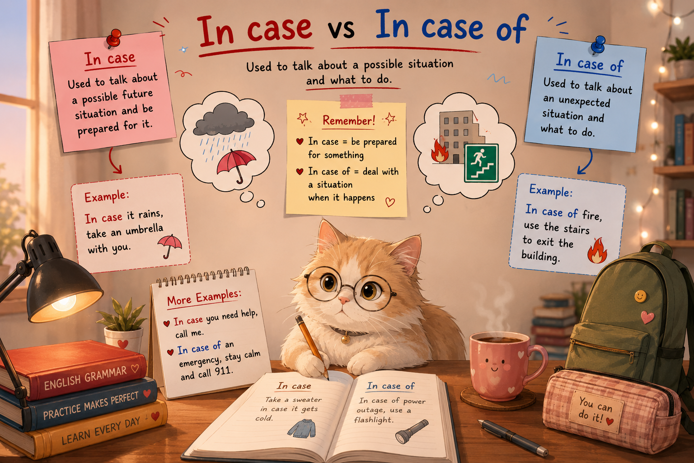

Slide 2
In case
“In case” ko‘pincha “ehtimol bo‘lishi mumkin bo‘lgan vaziyatga tayyor bo‘lish uchun” ishlatiladi. in case = ehtimol bo‘lsa / bo‘lib qolsa / tayyorlik uchun. Bu “agar” (if) bilan bir xil emas.
Conjunction : Main clause + in case + Present Simple
  In case I forget later, here are the keys to the garage.
  I’ll take cash in case we need it on the ferry.
In case dan keyin odatda Present Simple ishlatiladi, hatto kelajak ma’nosi bo‘lsa ham.✅ in case he is hungry ❌ in case he will be hungry

Slide 3
As Adverb
Ba’zan just in case alohida ham ishlatiladi.
She doesn’t want to say anything just in case.
  U har ehtiyot deb, hech narsa aytishni istamayapti.
Take an umbrella, just in case.
  Har ehtiyot uchun soyabon ol.
Bu yerda just in case = ehtiyot uchun / bo‘lib qolsa.

Slide 4
“In case” = “if” emas
I’ll take cash in case we need it on the ferry.
I’ll take cash if we need it on the ferry.
In case | If
Let’s take our swimming costumes in case there’s a pool at the hotel. | Let’s take our swimming costumes if there’s a pool at the hotel.
Biz basseyn bor-yo‘qligini bilmaymiz, lekin tayyor bo‘lyapmiz. | Avval basseyn borligini bilamiz, keyin qaror qilamiz.

Slide 5
In case qachon ishlatiladi?
Tayyor bo‘lish uchun
    Take a jacket in case it gets cold.
    Sovuq bo‘lib qolsa deb, kurtka ol.
Ehtiyot chorasi sifatida
    Write down the address in case your phone dies.
    Telefoning o‘chib qolsa deb, manzilni yozib qo‘y.
Kelajakdagi noma’lum vaziyat uchun
    We bought extra food in case guests come.
    Mehmonlar kelib qolsa deb, qo‘shimcha ovqat oldik.

Slide 6
Important Rule
In case + Present Simple
Kelajak haqida gapirayotgan bo‘lsak ham:
✅ Take your passport in case they ask for it.
❌ Take your passport in case they will ask for it.
Xuddi if va when dagi kabi, in case dan keyin ham odatda will ishlatilmaydi.

Slide 7
IN CASE OF + noun
In case of + noun = “agar … bo‘lsa / sodir bo‘lsa / yuz bersa”
Bu favqulodda holatlar (emergency situations) uchun ishlatiladi.
In case of + noun, + imperative (buyruq gap)
In case of breakdown, please press the alarm button and call this number.
Lift buzilib qolsa, signal tugmasini bosing va shu raqamga qo‘ng‘iroq qiling.

Slide 8
More Examples
In case of fire, use the stairs.
Yong‘in bo‘lsa, zinadan foydalaning.
In case of emergency, call 911.
Favqulodda holatda 911 ga qo‘ng‘iroq qiling.
In case of breakdown, stop the car immediately.
Mashina buzilsa, darhol to‘xtating.
In case of illness, stay at home. Kasallik bo‘lsa, uyda qoling.
In case of delay, wait here. Kechikish bo‘lsa, shu yerda kuting.

Slide 9
IN CASE vs IN CASE OF
Structure | Example | Meaning
in case + sentence | Take an umbrella in case it rains | bo‘lib qolsa deb (tayyorgarlik)
in case of + noun | In case of rain, stay inside | agar/yuz bersa (rasmiy ko‘rsatma)
Take an umbrella in case it rains. Yomg‘ir yog‘ib qolsa deb soyabon ol.
In case of rain, stay indoors. Yomg‘ir bo‘lsa, ichkarida qoling.

Slide 10
IF ONLY
If only = kuchli orzular / afsus / istak bildiradi. “Qaniydi / Koshki” degan ma’noni beradi va “I wish” dan kuchliroq.
Expression | Strength
I wish | normal wish
If only | stronger, emotional
I wish he was here.
If only he were here! (kuchliroq)

Slide 11
PRESENT (hozirgi holat)
Formula: If only + Past Simple - Haqiqiy holat: hozir shunday EMAS
If only he knew the truth. Qaniydi u haqiqatni bilsa. (lekin u bilmaydi)
If only I had more money. Qaniydi menda ko‘proq pul bo‘lsa.
If only she weren’t so tired. Qaniydi u bunchalik charchamagan bo‘lsa.
Formal: were (was emas)
  If only he were here.

Slide 12
FUTURE (kelajak istagi)
Formula: If only + would + verb - O‘zgarishini xohlaymiz
If only someone would help me.
  Qaniydi kimdir menga yordam bersa.
If only he would listen.
  Qaniydi u quloq solsa.
If only it would stop raining.
  Qaniydi yomg‘ir to‘xtasa.

Slide 13
PAST (o‘tgan afsus)
Formula: If only + Past Perfect - O‘tgan voqea uchun afsus
If only I had studied harder.
  Qaniydi ko‘proq o‘qigan bo‘lsam edi.
If only he had come earlier.
  Qaniydi u ertaroq kelgan bo‘lsa edi.
If only she hadn’t said that.
  Qaniydi u buni aytmagan bo‘lsa edi.

Slide 14
Common mistakes
❌ If only he knows the truth
✔ If only he knew the truth
❌ If only she is here
✔ If only she were here
❌ If only he will come
✔ If only he would come

Slide 15
Summary
Zamon | Formula | Meaning
Present | If only + past | hozir boshqacha bo‘lishini xohlaymiz
Future | If only + would | o‘zgarishini xohlaymiz
Past | If only + past perfect | afsus (o‘tgan)
If only I had started earlier, I would have passed the exam.
If only he would take my advice.
If only I were more confident.

